Slide 1
The Complete Aspen Row Analysis Project
Team ELMentary Econometricians
Sakir Inteser, Tyler Rodriguez, Thomas Mowery
ECON 5645 – Empirical Linear Modeling
University of North Texas
May 8th, 2024

Slide 2
Who is Aspen Row?
The client for our project is ‘Aspen Row’, a seller of furniture and textiles.
Their motto is "A beautifully furnished home is a sanctuary that tells a unique story, and we are here to help you craft yours with style and grace."
Through 2022, Aspen Row has experienced rapid growth in its key markets.
Although they have been successful with their expansion efforts, they are now running out of “easy win” locations and need help identifying areas with strong revenue potential.
The initial strategy was aggressive expansion.
However, they are now focusing on conservative expansion.

Slide 3
Purpose of This Project
Our primary objective is to help Aspen Row grow more efficiently by only opening stores in high-revenue potential locations.
For that, we will build a regression model to explain Sales at Aspen Row’s locations.
Definitions:
Sales: This is the dependent variable. It is defined as the dollar value of sales at store "i" during 2023.
Store_ID: Store identification number.

Slide 4
Pre-model Analysis
For the pre-model analysis, we made sure that there were no unreasonable data of SALES (Values that were either 0 or some other unreasonable value, such as negative sales). Ignoring these unreasonable data can cause our regression model to have biased and misleading results.
We also looked for outlier observations as their presence can also lead to misleading results.
Formula for identifying outliers: Mean ± 2.5∗standard deviation
High outlier: 14,599,464.03 + 2.5 * 7,057,856.8= 32,244,106.03
Low outlier: 14,599,464.03 - 2.5 * 7,057,856.8 = -3,045,177.97
Graph 1: Scatter plot for Sales (for “clean” observations)
Table 1: Summary Statistics for Sales (for "clean" observations)
N | Mean | Std Dev | Minimum | Maximum | CV
64 | 14,318,647 | 6,737,721 | 1,064,501 | 32,161,128 | 47.06

Slide 5
Pre-model Analysis
For the independent variables, we checked for missing values, unreasonable means, standard deviations that are 0, unreasonable maximum and minimum values, and sufficient variations.
Any variables that had problems that could not be corrected were excluded from further consideration.

Slide 6
Definitions Of The Chosen Regressors
These regressors are chosen based on economic theory and logic to explain sales at Aspen Row, and also based on their correlation coefficients with Sales.
Table 2: Definitions of the Chosen Regressors.
Variables | Defintition
Xpop_70_85_25dtm | The percentage of people, age 70 to 85, who live within 25 drive-time-minutes of store "i".
Xretail_25dtm | The percentage of establishments within 25 drive-time-minutes of store "i" that are retail shops.
movies_power_centers_25dtm* | The total number of movie theaters and power centers (big box stores) located within 25 drive time minutes of store "i".​
likely_customers_index | An index of how likely residents who live in the trade area are to be customers.
growth_projection_25dtm | The projected population growth rate, within 25 drive-time-minutes of store "i", over the next 5 years.
malls_lavish_25dtm* | The total number of high-end and luxury malls located within 25 drive time minutes of store "i".​
hh_3person_10dtm | The number of 3-person households located within 10 drive-time minutes of store "i".
dining_1rm* | The total number of casual, high-end, and luxury dining establishments located within 1 radial mile of store "i".​
homes_500_999K_25dtm | The number of homes within 25 drive-time-minutes of store "i" that are valued from $500,000 to $999,000
*A variable that was created using other variables within the dataset.

Slide 7
Chosen Regressors – Created Variables
Malls_lavish_25dtm = malls_hi_25dtm + malls_luxury_25dtm
This variable encompasses the fact that Aspen Row is a high-end or luxury furniture store and can benefit by locating near both high-end and luxury malls.
Movies_power_centers_25dtm = movie_theaters_25dtm + power_centers_25dtm
We found that areas with a high number of movie theaters tend to also have a high number of power centers (highly positively correlated) causing a high multicollinearity issue.
While individually, both were insignificant regressors, once combined they became significant.
Dining_1rm = dining_casual_1rm + dining_hi_1rm + dining_luxury_1rm
No matter what type of dining establishment Aspen Row is located near, sales will always increase if the number of dining establishments increases.

Slide 8
Correlation Coefficient Of The Chosen Regressors
Table 3: Correlation Coefficient of the Chosen Regressors.
Regressors | Correlation between SALES and Regressors | P Value (H0 = Correlation = 0)*
Xpop_70_85_25dtm | 0.23914 | 0.055
Xretail_25dtm | -0.42045 | 0.0005
movies_power_centers_25dtm | 0.46208 | 0.0001
likely_customers_index | 0.46596 | <.0001
growth_projection_25dtm | 0.22127 | 0.0765
malls_lavish_25dtm | 0.62801 | <.0001
hh_3person_10dtm | 0.2233 | 0.0738
dining_1rm | 0.36044 | 0.0032
homes_500_999K_25dtm | 0.535 | <.0001
* at the 90% level of confidence

Slide 9
Summary Statistic Of The Chosen Regressors
Table 4: Summary Statistic of the Chosen Regressors.
Variable​s | N​ | Mean​ | Std Dev​ | Minimum​ | Maximum​
Xpop_70_85_25dtm​ | 64​ | 11.42​ | 3.62​ | 6.03​ | 29.10​
Xretail_25dtm​ | 64​ | 10.11​ | 1.15​ | 6.84​ | 12.51​
movies_power_centers_25dtm​ | 64​ | 131.58​ | 64.49​ | 26​ | 377​
likely_customers_index​ | 64​ | 47,676,292​ | 22,773,588​ | 9,012,754​ | 114,037,957​
growth_projection_25dtm​ | 64​ | 2.90​ | 2.84​ | -1.72​ | 10.70​
malls_lavish_25dtm​ | 64​ | 69.81​ | 40.79​ | 9​ | 190​
hh_3person_10dtm​ | 64​ | 2,659​ | 1,477​ | 269​ | 6,783​
dining_1rm​ | 64​ | 10.97​ | 8.46​ | 0​ | 36​
homes_500_999K_25dtm​ | 64​ | 34,757​ | 30,633​ | 3,494​ | 141,623​

Slide 10
Best Contender Models
Table 5: Best Contender Models
Model | Variables
S7 | Xpop_70_85_25dtm, Xretail_25dtm, likely_customers_index, growth_projection_25dtm, mall_lavish_25dtm, dining_1rm, homes_500_999K_25dtm
AY6 | Xpop_70_85_25dtm, Xretail_25dtm, growth_projection_25dtm, hh_3person_10dtm, dining_1rm, homes_500_999K_25dtm
BB6 | Xpop_70_85_25dtm, Xretail_25dtm, growth_projection_25dtm, mall_lavish_25dtm, hh_3person_10dtm, dining_1rm
BG6 | Xpop_70_85_25dtm, Xretail_25dtm, likely_customers_index, growth_projection_25dtm, dining_1rm, homes_500_999K_25dtm
BN6 | Xpop_70_85_25dtm, Xretail_25dtm, movies_power_centers_25dtm, mall_lavish_25dtm, dining_1rm, homes_500_999K_25dtm

Slide 11
Fit Statistics of the Best Contender Models
Table 6: Values of Fit Statistics for Select Models
Model | Calc. General F Test (p-value)⁺ | R² | Adjusted R² | # of significant* slopes with correct sign | # of significant* slopes with incorrect sign | Value of OOS MAPE
S7 | 16.72 (<.0001) | 0.6725 | 0.6323 | 6 out of 7 | 0 out of 6 | 5.99%
AY6 | 14.45 (<.0001) | 0.5992 | 0.5578 | 6 out of 6 | 0 out of 6 | 9.03%
BB6 | 18.16 (<.0001) | 0.6527 | 0.6167 | 6 out of 6 | 0 out of 6 | 6.61%
BG6 | 18.38 (<.0001) | 0.6554 | 0.6197 | 6 out of 6 | 0 out of 6 | 8.03%
BN6 | 19.19 (<.0001) | 0.6651 | 0.6304 | 6 out of 6 | 0 out of 6 | 6.03%
⁺ H0: the variables, as a group, cannot explain the dependent variable;
* at the 90% level of confidence

Slide 12
Fit Statistics of the Best Contender Models
Table 7: Assessment of Fit Statistics for Select Models
Model | Calc. General F Test (p-value)⁺ | R² | Adjusted R² | # of significant* slopes with correct sign | # of significant* slopes with incorrect sign | Value of OOS MAPE
S7 | significant | Best | Best | 86% | None | Best
AY6 | significant | Least Strong | Least Strong | 100% | None | Good
BB6 | significant | Strong | Strong | 100% | None | Very Good
BG6 | significant | Strong | Strong | 100% | None | Good
BN6 | significant | Very Strong | Very Strong | 100% | None | Very Good
All the models are acceptable models from the perspective of fit statistics.
We are going to pick model BN6 as our final contender model.

Slide 13
Multicollinearity
Table 8: Variable Pairs that have Moderate to Severe Multicollinearity
Variable Pairs | Multicolinearity
movies_power_centers_25dtm & likely_customers_index | 0.90135
movies_power_centers_25dtm & malls_lavish_25dtm | 0.71351
movies_power_centers_25dtm & hh_3person_10dtm | 0.57773
likely_customers_index & malls_lavish_25dtm | 0.7668
likely_customers_index & hh_3person_10dtm | 0.69469
likely_customers_index & homes_500_999K_25dtm | 0.52838
malls_lavish_25dtm & homes_500_999K_25dtm | 0.62254
A correlation coefficient over 0.5 indicate the presence of moderate to severe multicollinearity which can explain the reason the variables listed above may be insignificant in the models in which the pairs shown above appear together.

Slide 14
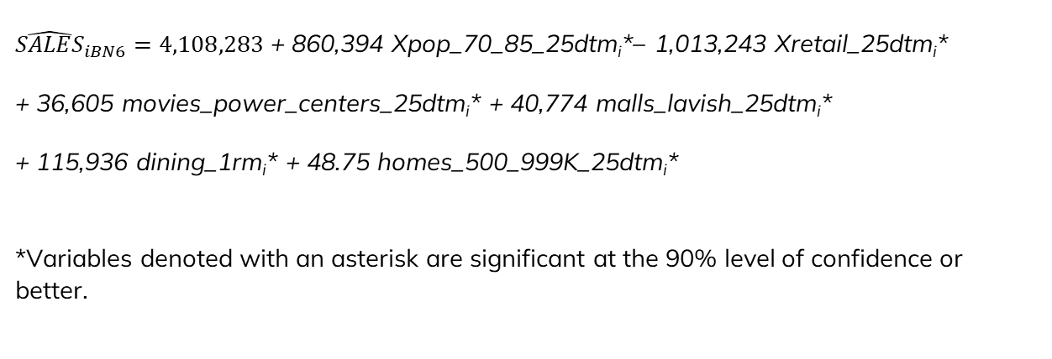
Final Contender Model
${\hat{SALES}}_{iBN6}=4,108,283$ + 860,394 Xpop_70_85_25dtm_{i}*– 1,013,243 Xretail_25dtm_{i}* + 36,605 movies_power_centers_25dtm_{i}* + 40,774 malls_lavish_25dtm_{i}* + 115,936 dining_1rm_{i}* + 48.75 homes_500_999K_25dtm_{i}*
*Variables denoted with an asterisk are significant at the 90% level of confidence or better.

Slide 15
Best Model Regressor Interpretations
Xpop_70_85_25dtm: For every 1% increase in the population of individuals ages 70-85 years old within 25 drivetime minutes of a given Aspen Row location, that store's annual sales will increase by $860,394 on average, ceteris paribus.
Xretail_25dtm: For every 1% increase in the number of retail stores located within 25 drivetime minutes of a given Aspen Row location, that store's annual sales will decrease by $1,013,243 on average, ceteris paribus.
Movies_power_centers_25dtm: For every additional movie theater or power center that is located within 25 drivetime minutes of a given Aspen Row location, that store's annual sales will increase by $36,305 on average, ceteris paribus.
Malls_lavish_25dtm: For every additional high-end or luxury mall located within 25 drivetime minutes of a given Aspen Row location, that store's annual sales will increase by $40,774 on average, ceteris paribus.
Dining_1rm: For every additional dining establishment (this includes casual, high-end, and luxury establishments) located within 1 radial mile of a given Aspen Row location, that store's annual sales will increase by $115,936 on average, ceteris paribus.
Homes_500_999K_25dtm: For every additional home that is valued from $500,000 to $999,000 within 25 drivetime minutes of a given Aspen Row location, that store's annual sales will increase by $48.75 on average, ceteris paribus.

Slide 16
Threshold Value
Table 9: Summary Statistics for Sales (for "clean" observations)
N | Mean | Std Dev
64 | $ 14,318,647 | $ 6,737,721
Low Potential: Predicted Yi < Mean = Predicted Yi < $ 14,318,647
Above Average Potential: Mean <= Predicted Yi < (Mean + 1 std. dev) = $ 14,318,647 <= Predicted Yi < $21,056,367
Medium Potential: (Mean + 1 std. dev) <= Predicted Yi < (Mean + 2 std. dev) = $21,056,367 <= Predicted Yi < $27,794,088
High Potential: Predicted Yi > (Mean + 2 std. dev) = > $27,794,088
$ 14,318,647
$21,056,367
$27,794,088
Low Potential
Above Average Potential
Medium Potential
High Potential

Slide 17
Projected Sales for Potential Locations
Table 10: Values of the Regressors for the Potential Locations
Store_ID | Projected sales | Model Scoring | Xpop_70_85_25dtm | Xretail_25dtm | movies_power_centers_25dtm | malls_lavish_25dtm | dining_1rm | homes_500_999K_25dtm
72 | 18,467,320 | Above Average | 12.41 | 9.29 | 104 | 99 | 32 | 31,613
73 | 24,413,720 | Medium | 7.9 | 10.01 | 313 | 177 | 24 | 45,008
74 | 10,476,878 | Low | 6.9 | 11.02 | 160 | 45 | 26 | 18,295
75 | 13,803,706 | Low | 10.68 | 10.44 | 194 | 45 | 7 | 27,425
76 | 3,647,539 | Low | 10.61 | 13.22 | 63 | 16 | 0 | 17,376
77 | 6,242,160 | Low | 13.6 | 13.13 | 33 | 39 | 7 | 2,599

Slide 18
Projected Sales for Potential Locations
Table 11: Sales Projection Results
Revenue Type | Description | Store Number
High Potential | Projected sales ≥ (average sales plus two standard deviations) | None
Medium Potential | Projected sales ≥ (average sales plus one standard deviation) but Projected sales < (average sales plus two standard deviations) | 73
Above Average Potential | Projected sales ≥ average sales but Projected sales < (average sales plus one standard deviations) | 72
Low Potential | Projected sales < average sales | 74, 75, 76, 77
Table 12: Threshold Values for Potential Sales
Sales Level | Value of Sales
Average Sales | $14,318,647
Average + 1 std. dev. | $21,056,367
Average + 2 std. dev. | $27,794,088

Slide 19
Comparison between medium potential stores & low potential stores
These are the performance metrics for the low potential stores compared to the medium potential stores.
Graph 2a & 2b: Comparison between medium potential stores & low potential stores.

Slide 20
Comparison between medium potential stores & low potential stores
Graph 2c & 2d: Comparison between medium potential stores & low potential stores.

Slide 21
Recommendations
We currently do not have any high potential location estimated by our model.
While we do not recommend opening any of these stores, we do have some suggestions that you should consider.
We analyzed the characteristics of the existing high-sales stores of Aspen Row to determine what should Aspen Row strive for when pursuing high potential locations.

Slide 22
Comparison between existing high sales stores & low sales stores.
Graph 3a, 3b, 3c, 3d: Comparison between existing high sales stores & low sales stores.

Slide 23
Comparison between high potential stores & low potential stores
Graph 3e: Comparison between high sales stores & low sales stores.

Slide 24
Performance Metrics of Existing High Sales Stores
Some performance metrics of high sales store that Aspen Row should strive for:
Table 13: Mean of Select Independent Variables of High Sales Stores
Variables | Mean
Xpop_70_85_25dtm | 14.46
Xretail_25dtm | 8.83
movies_power_centers_25dtm | 208.5
malls_lavish_25dtm | 121.75
Dining_1RM | 19.25
homes_500_999K_25dtm | 67,772
Xpop_married_25dtm | 53.42
hhinc_ge_100K_25dtm | 172,925.75
pop_40_85_25dtm | 488,519.25
Xpop_ge_bachelors_25dtm | 48.82

Slide 25
Recommendations
Specific recommendations within the model:
Locating in an area with a greater than or equal to 14.46% of people aged 70 to 85 within a 25-minute drive has a strong positive effect on Sales.
It is not advisable to locate near areas with more than 8.8% of retail stores within 25 drive time minutes, as it will have a strong negative impact on sales.
Selecting areas with more than or equal to 208 movie theaters and power centers (big box stores) within 25 drive time minutes will be optimal, as they work as cotenants and will drive up sales.
Locating near high end and luxury malls within 25 drive time minute will have a strong positive effect on sales.
Locating near areas with casual, high end, and luxury dining services within 1 radial mile will have a strong positive effect on sales.
Locating in an area with more than or equal to 67,772 homes within 25 drive-time-minutes that are valued from $500,000 to $999,000 has a strong positive effect on sales.

Slide 26
Recommendations
General recommendations outside the model:
Locating in an area with a greater than or equal to 53% of married people within 25 drive time minutes has a strong positive effect on Sales.
Targeting areas with household incomes greater than $100,000 contributes positively to sales performance.
While our target customer base age ranges from 70 to 85, extending the range to 40- to 85-year-old people residing within a 25-minute drive will also be likely to have favorable sales outcomes.
Targeting highly educated people with bachelor’s degrees or above as potential customers will likely to increase sales, as the existing high potential stores has about 48% of customers who has a bachelor’s degree or higher.

Slide 27
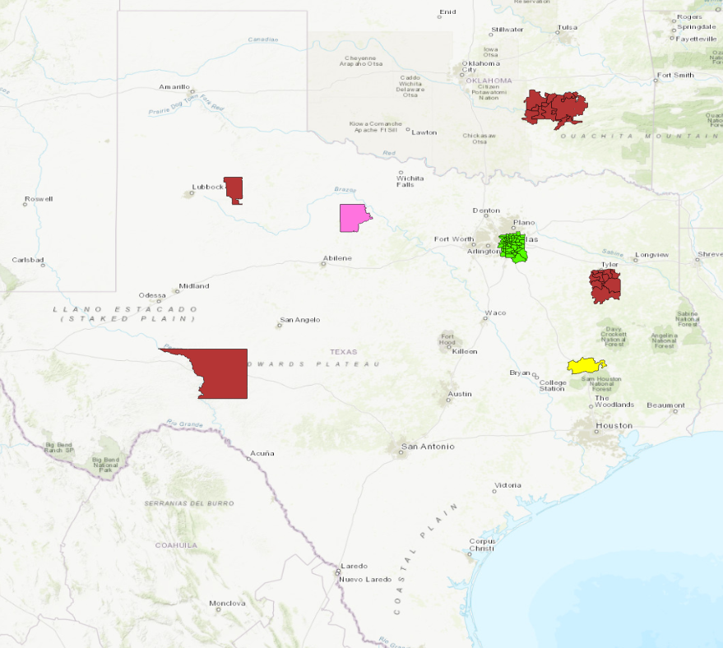
Mapping Potential Locations - ArcGIS
Image 1: "Potential" Locations in ArcGIS
Using a mixture of Python and ArcGIS, we aim to make future analysis of potential locations simple and easy for anyone at Aspen Row.
With the different colors denoting different threshold values:
Our ArcGIS map only requires an excel spreadsheet of data, like what was given to us, and using zip codes will show the potential sales of Aspen Row.
Green – High Potential Sales
Yellow – Medium Potential Sales
Pink – Above-Average Potential Sales
Red – Low Potential Sales

